Slide 1
BoardGameGeek
Analysis
Bill Best

Slide 2
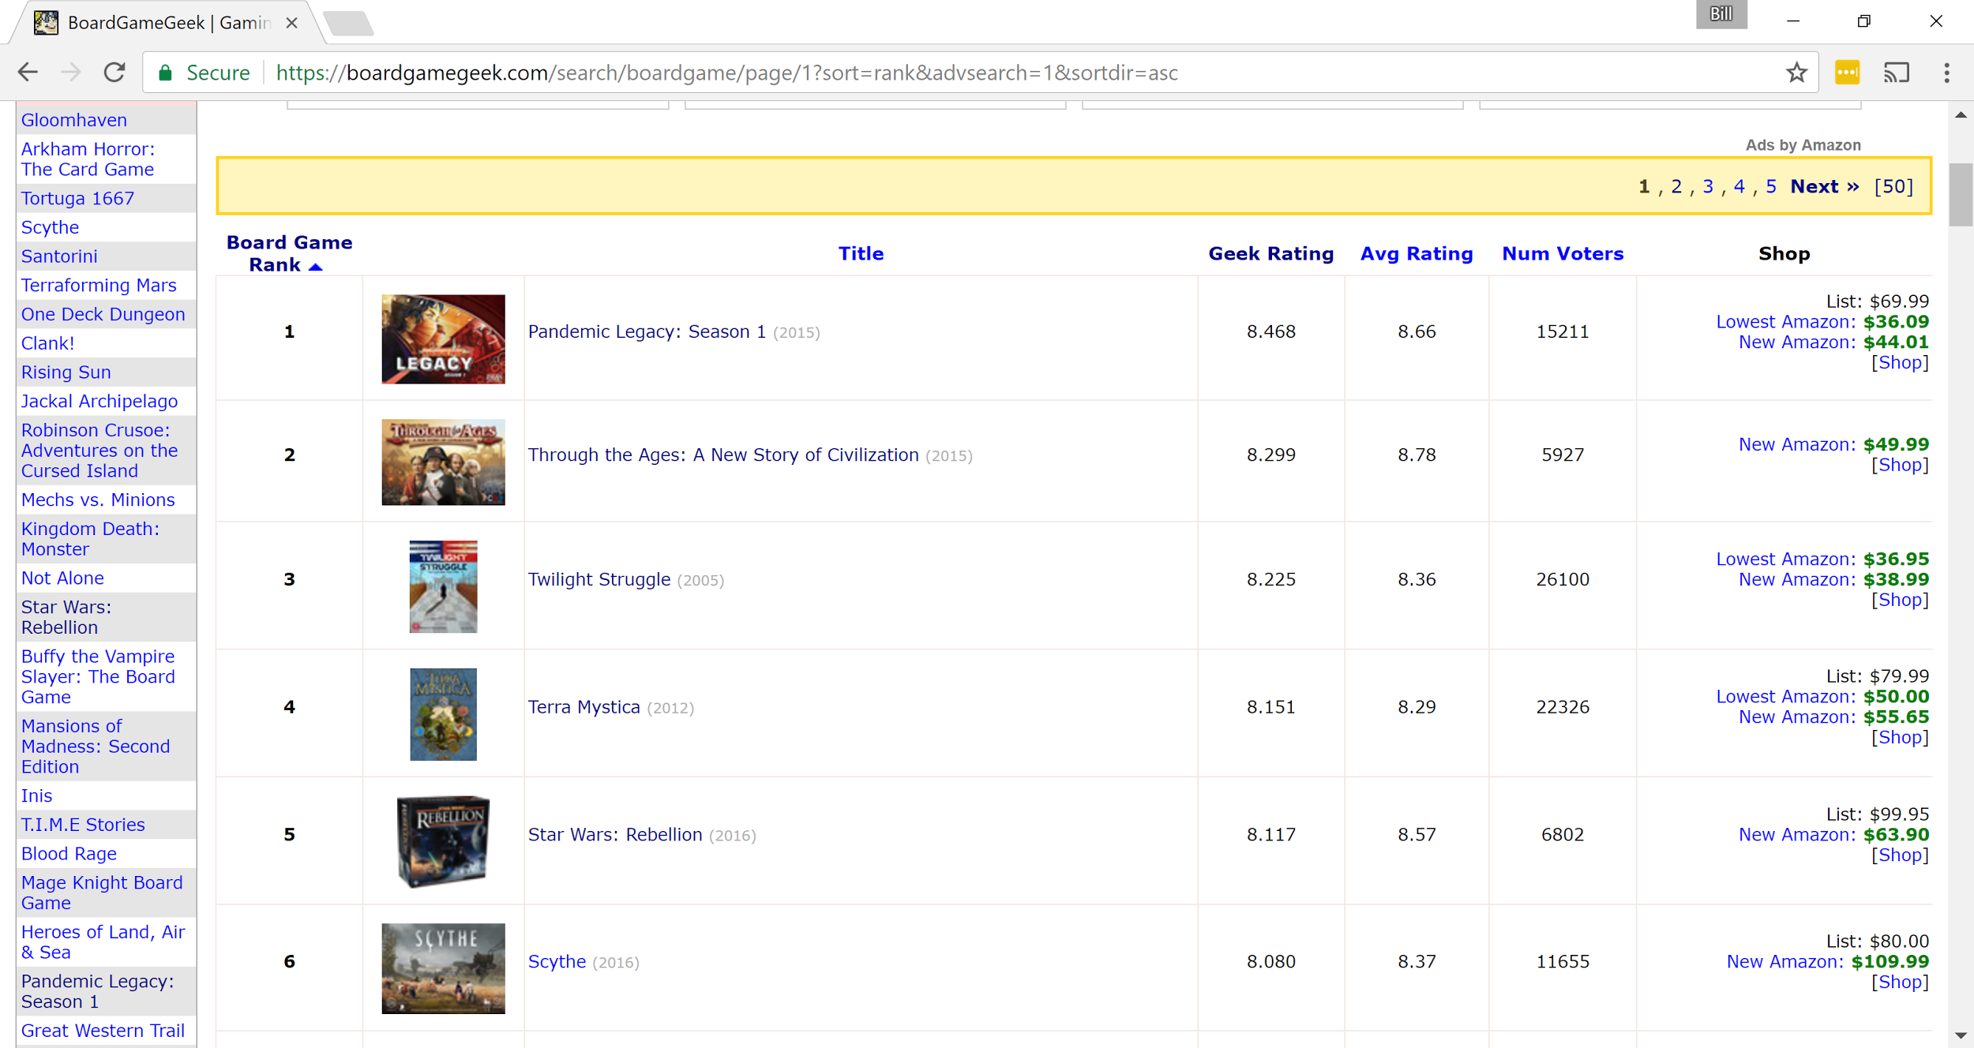
Introduction - Search Page Example

Slide 3

Introduction - Game Page Example

Slide 4
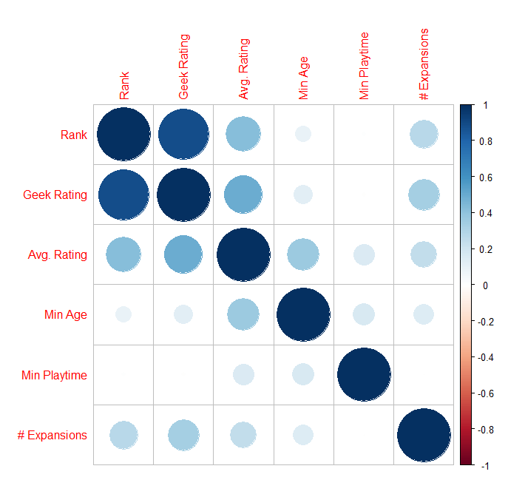
Game Feature Correlation
Notes:
“Game” features like these have little bearing on rank, # Expansions looks like it might, but it’s probably the reverse. The popular game has more expansions

Slide 5
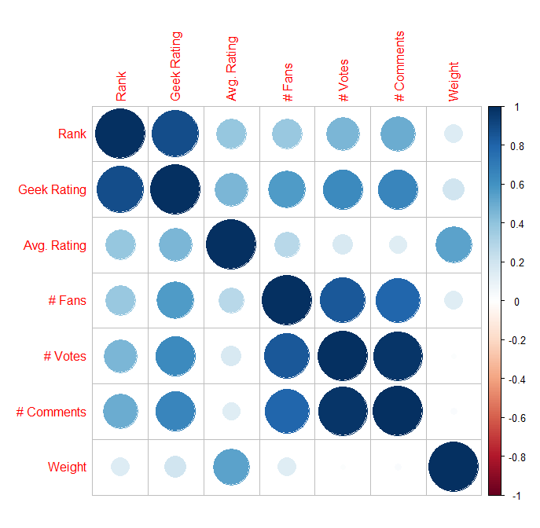
Opinion Feature Correlation
Notes:
Geek Rating is strongly correlated with Rank, this stands to reason as it is how rank is determined.

Slide 6
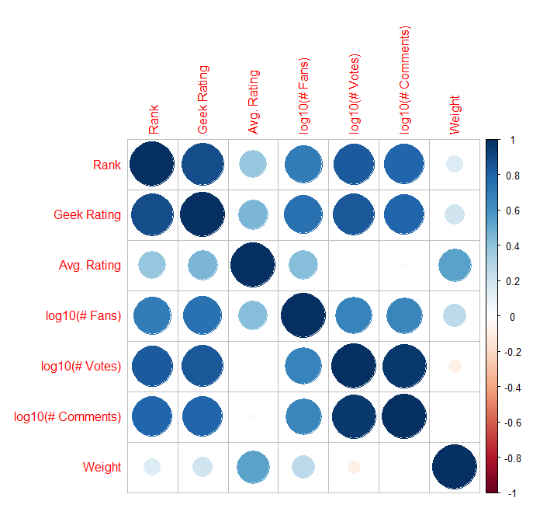
Opinion Feature Correlation 2 - log10(Counts)
Notes:
If we take the log of the “num” variables, they become much more strongly correlated
Using this method, the best non-rating element is Votes

Slide 7
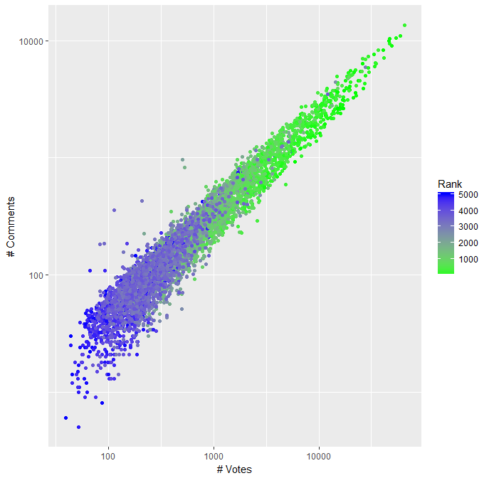
LogLog Graph of Votes vs Comments
Notes:
Again, visible here is the strong correlation between # Votes, # Comments, and Rank

Slide 8
Game Category Analysis
Noted tendencies
Higher Rating: War games
More fans: Thematic games (Sci-fi, horror, etc)
More comments: Building and Adventure games
More votes: Building and Adventure games
Again, comments and votes are highly correlated
Notes:
Ran two-sample t.test against rest of games for each category
War games not likely to get more fans, votes, or comments than average despite higher ratings
Building includes economic games and political games, where you “build up” something
Zombie games are unlikely to be rated higher than average, but (probably) do get more fans (1.27e-10)

Slide 9
Game Mechanic Analysis
Game mechanics more varied
Top mechanics not always similar
Avg. Rating, Num. Votes, Num. Comments all had basically the same top mechanics but in slightly different orders
Hand Management and set collection are the two most popular
Notes:
While some mechanics are likely to increase rating, votes, and comments, but not fans. Things that are likely to increase fans are also likely to increase the others
Don’t make a game with a performance aspect though, people don’t like that. It shows up in all analysis I’ve done. I did simple ordering based on votes and ratings, and then this t.test, and performance is always low

Slide 10
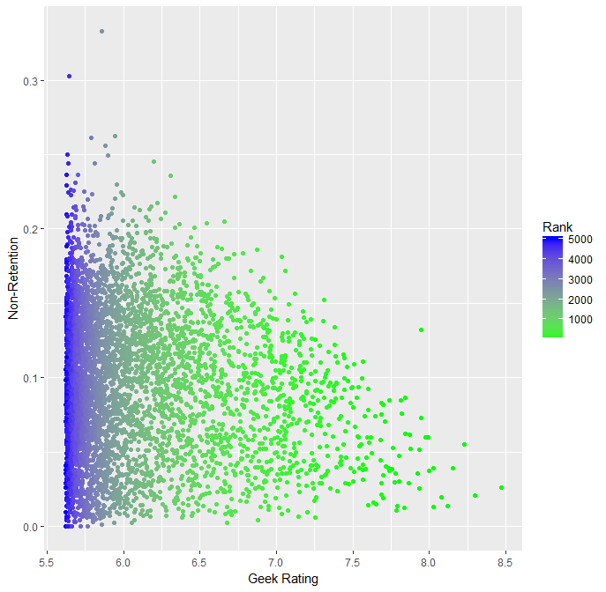
Non-Retention Rate
Notes:
How often people get rid of games, either through sale trade etc
This information was from own vs prev-owned

